Slide 1

Cellular automata and nature inspired computing
http://pavolondzik.github.io/GoL/
Pavol Ondzik
Denzel Dadson
Notes:
Today we will talk about Cellular automata and nature inspired computing. [how cellular automata model the nature.]

Slide 2
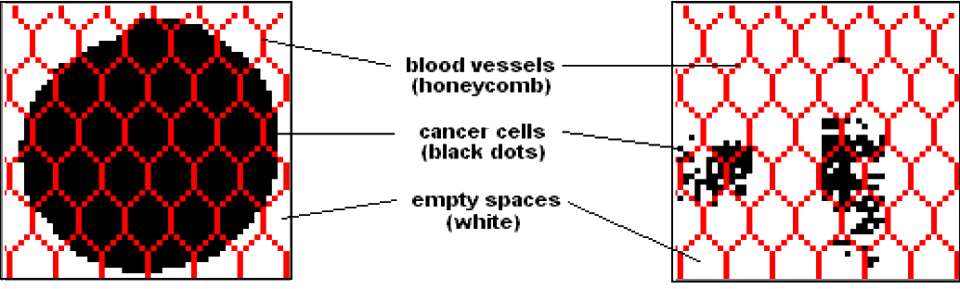
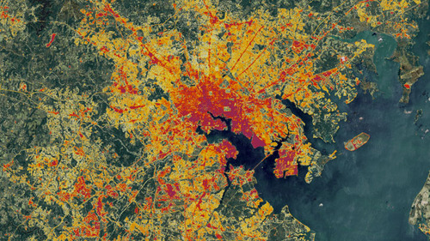
Cellular Automaton
Can be used for simulation of:
Social Movement
Ref: 1,2,3
Notes:
Cellular automata can be used for modeling of
Cancer cells growth
Forest Fires
Social Movement
Predator – Prey Models
Art
Biological Processes
What inspired us on biological processes is the possibility to recreate patterns and designs created by nature.

Slide 3


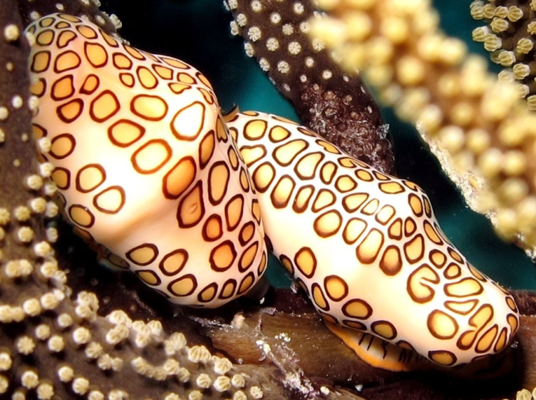
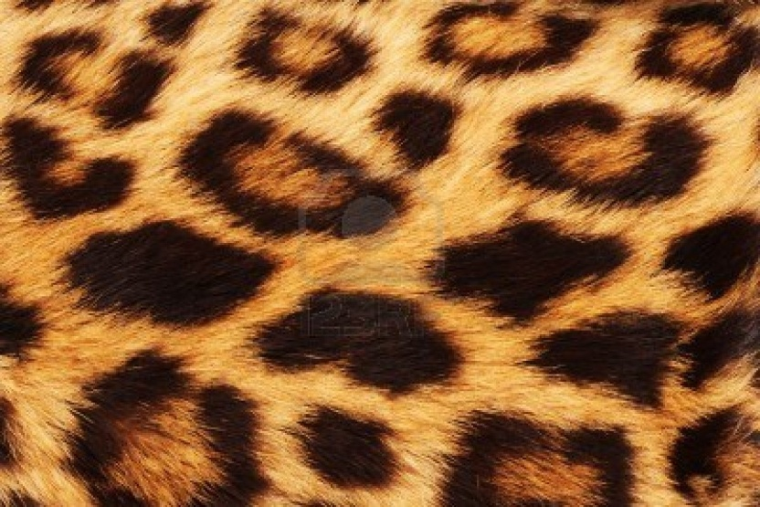
Patterns in nature
Royal Angelfish
Zebra
Modelled by Continuous Spatial Automata
Flamingo tongue snail
Leopard skin spots
Ref: 4, 5
Notes:
We have looked on patterns occurring on skins of different species.
As you can see, many animals have different or similar kind of patterns. Royal Angelfish and zebra have stripes, Flamingo tongue snail and leopard have spots.
To imitate more complex patterns like cheetah and leopard patterns[, or random stripes] a Continuous Spatial Automaton is needed.
Our task was to create cellular automaton, (which is simpler), that is why we have chosen Rule 30.
------------
Continuous spatial automata, unlike cellular automata, have a continuum of locations, while the state of a location is any of a finite number of real numbers. Time can also be continuous, and in this case the state evolves according to differential equations.
----------------

Slide 4
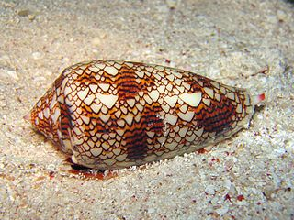
Rule 30
Introduced by Stephen Wolfram in 1983
Chaotic (Random number generator)
Rule 30 appears on the
cone shell of the predatory
sea snails
Marine gastropod mollusc
Ref: 6, 8
Notes:
Rule 30 was Introduced by Stephen Wolfram in 1983.
The rule 30 is used in infinity one dimensional automata. It has discrete time intervals.
The color of the shell is yellowish brown, with lines of chocolate, interrupted by triangular white spaces.
---------------------

Slide 5
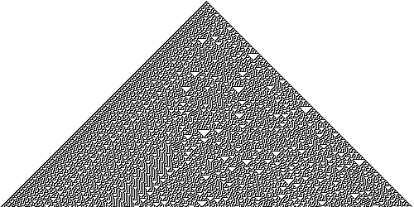
Cone shell pattern
Ref: 7
Notes:
Patterns of some seashells, like the ones in Conus and Cymbiola genus, are generated by natural cellular automata. The pigment cells reside in a narrow band along the shell's lip. Each cell secretes pigments according to the activating and inhibiting activity of its neighbour pigment cells, obeying a natural version of a mathematical rule. The cell band leaves the colored pattern on the shell as it grows slowly. For example, the widespread species Conus textile bears a pattern resembling Wolfram's rule 30 cellular automaton.
The following pattern emerges from an initial state in a single cell with state 1 (shown as black) is surrounded by cells with state 0 (white).
Here, the vertical axis represents time and any horizontal cross-section of the image represents the state of all the cells in the array at a specific point in the pattern's evolution. Several motifs are present in this structure, such as the frequent appearance of white triangles and a well-defined striped pattern on the left side; however the structure as a whole has no discernible pattern.

Slide 6
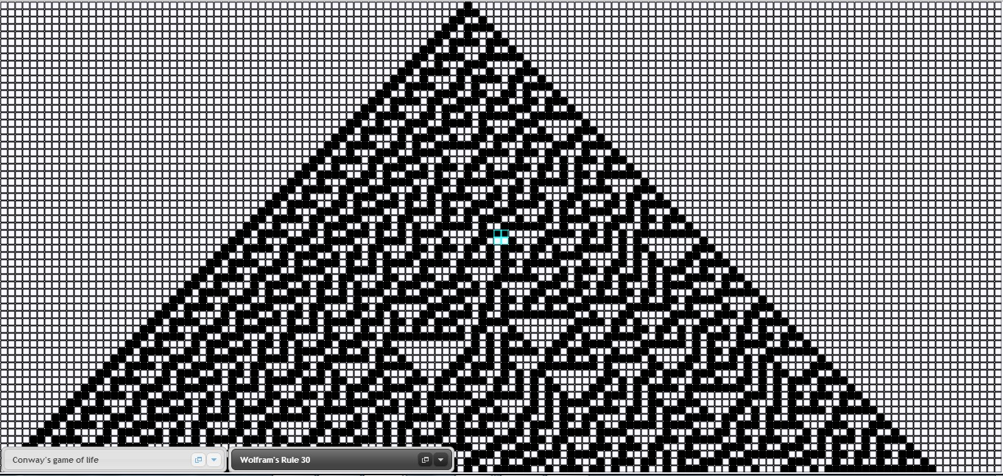
Our implementation (1)
Wolfram’s Rule 30
Notes:
I have decided to recreate Rule 30 in our web application. This is the result. It is pretty easy …

Slide 7
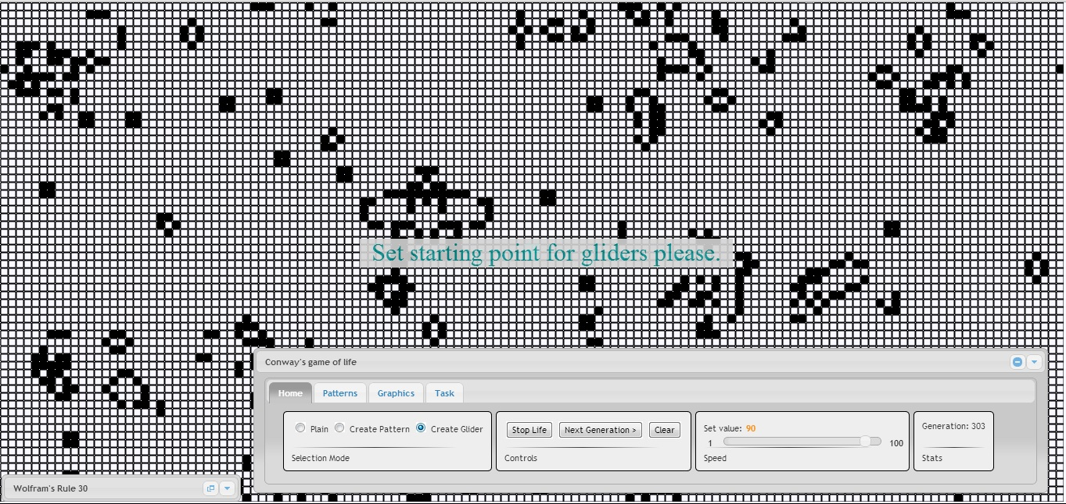
Our implementation (2)
Conway’s game of life
Notes:
… and Conway’s Game of Life.

Slide 8
What we have learned
Use of Cellular Automata
Patterns on animals
Different (Cellular) Automata
Rule 30
Different rules for CA
Our web application

Slide 9
Thank you for your attention!
Do you have any questions ?

Slide 10
References
http://prezi.com/t95re3syuttc/cellular-automata-and-nature-inspired-computing/
http://www.doc.ic.ac.uk/project/2012/163/g1216328/applications.htm
http://smarterplanet.tumblr.com/post/457087205/spime-nasa-uses-a-sleuth-to-predict-urban
http://en.wikipedia.org/wiki/Patterns_in_nature
http://news.brown.edu/pressreleases/2011/10/mollusks
http://en.wikipedia.org/wiki/Rule_30
http://www.cc.gatech.edu/~turk/my_papers/reaction_diffusion.pdf
http://www.ics.uci.edu/~eppstein/ca/wolfram.html

